Slide 1
Manga Reading Web Application
Web Programming - IT4552E - 131086
Members
Nguyễn Lưu Hoàng Minh - 20194798
Trần Hải Đăng - 20194738
Đinh Thế Kiệt - 20194783

Slide 2
Table of Contents
About Our Project
System Architecture
Features and Use-Cases
Contributions of Members
Demo

Slide 3
About Our Project
Github Repo: https://github.com/HoangMinhBK/WebProgramming_Group3.git

Slide 4
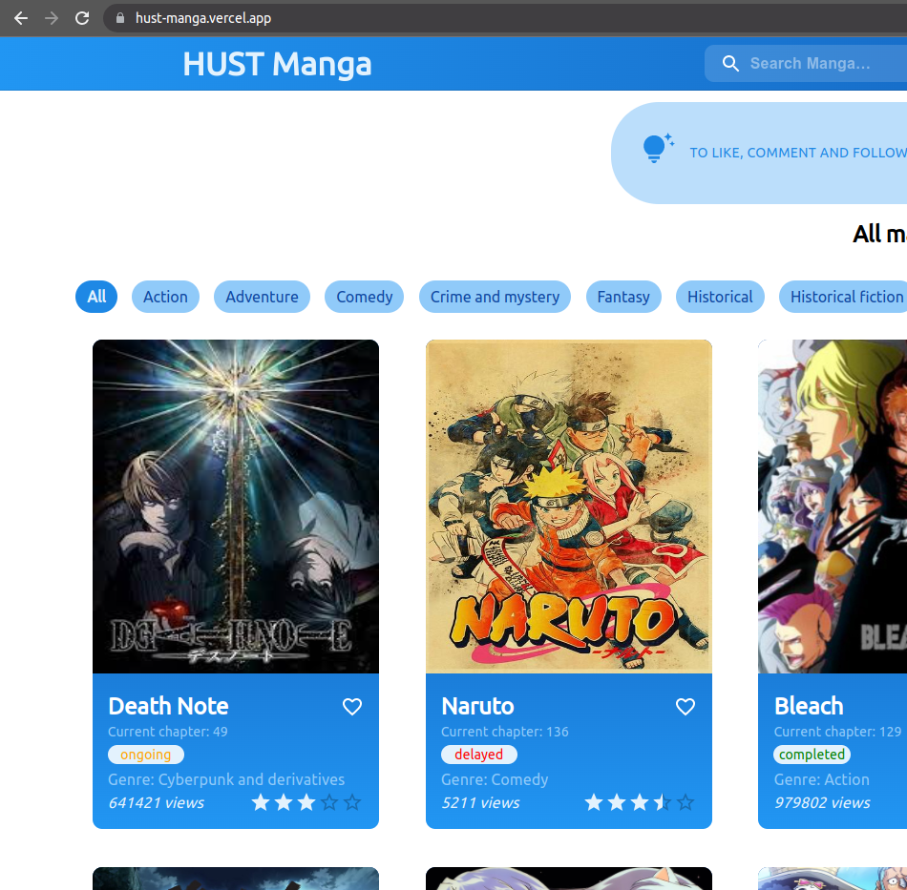
About our Web Application
HUST Manga is a website people can use to read high - quality comics from Japan.
User can also create their own accounts to manage their favorite comics and comment.

Slide 5
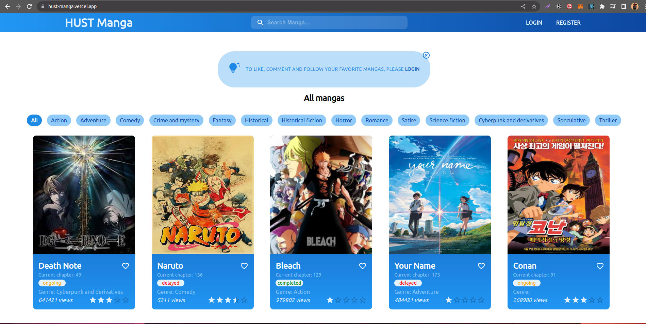

Responsive - Mobile and Desktop Support
Our website is fully responsive. It supports mobile and desktop devices.
Desktop version
Mobile version

Slide 6
2. System Architecture

Slide 7





Front-End
Technology:
Programming Language: JavaScript
Library: ReactJs, MUI, Axios
Environment: Node

Slide 8


Back-End / Overview
Technology:
Programming Language: Python
Framework: FastAPI

Slide 9
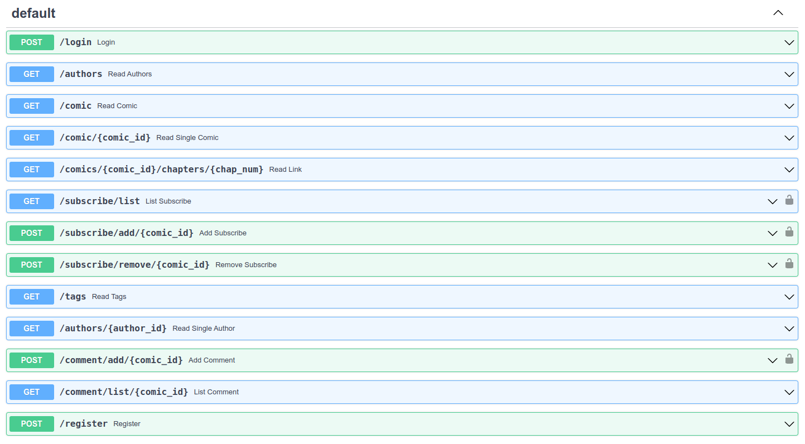
Back-end / API

Slide 10
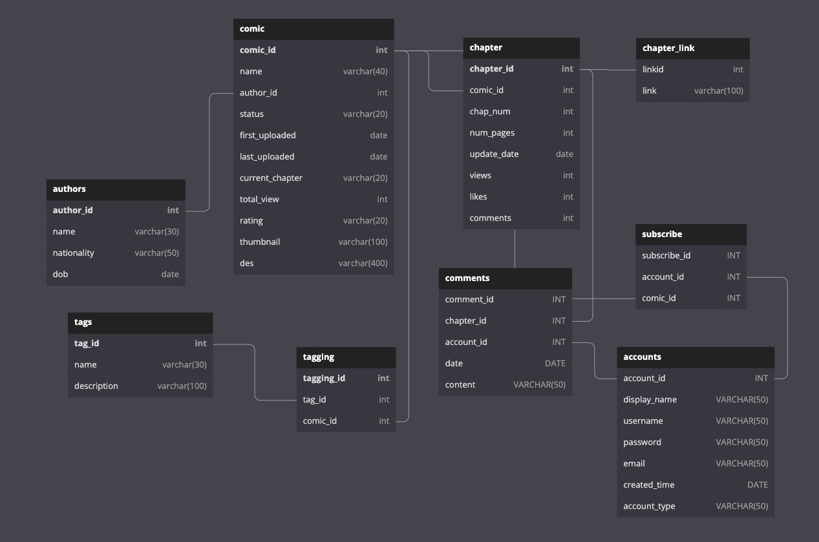
Database - MySQL

Slide 11
Deployment
Front-end:
Our website is deployed on Vercel.
URL: https://hust-manga.vercel.app/
Back-end:
Our server is deployed on DETA.
Database:
Our database is hosted on https://www.freemysqlhosting.net/

Slide 12
3. Features and Use-Cases

Slide 13
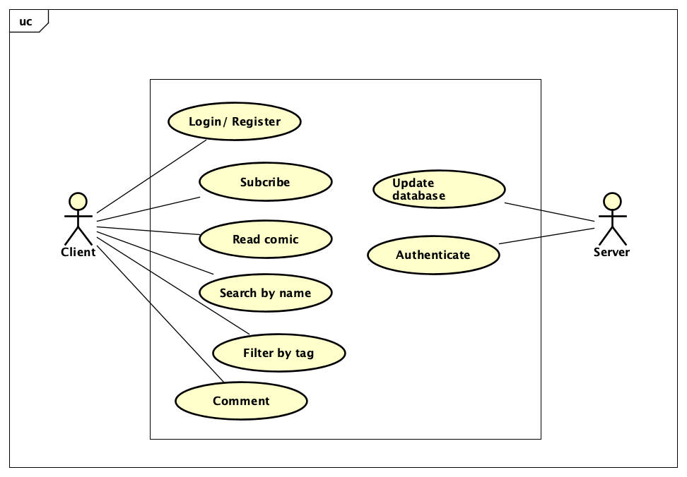
Use-Case diagram

Slide 14
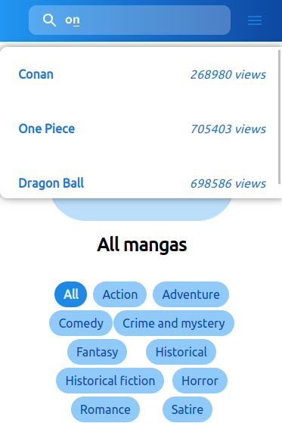
Search manga by name
User can search for a certain manga by typing texts on the search bar. Any mangas having matched symbols will be shown.

Slide 15
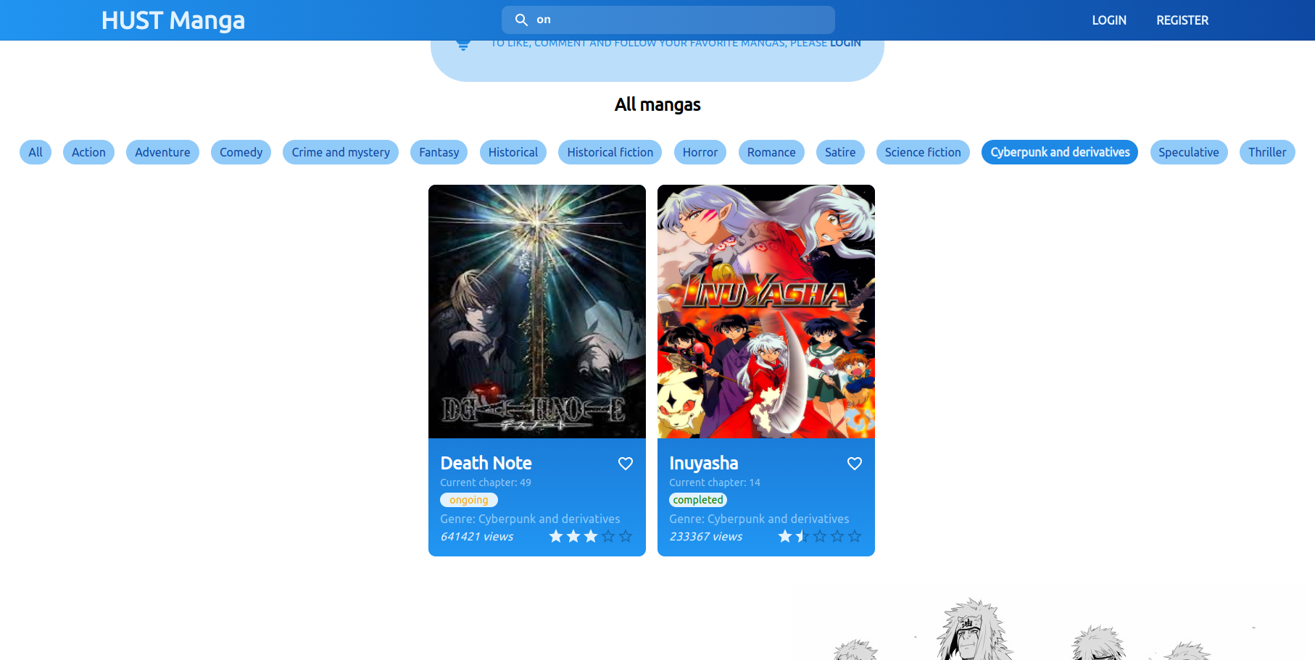
Filter mangas by tags
There are a few tags available. Users can use them to filter mangas they want.

Slide 16

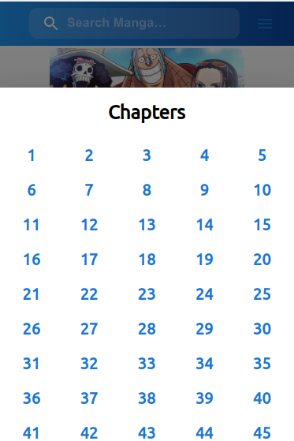

Read Manga
Choose comic
Choose chapter
Start reading

Slide 17
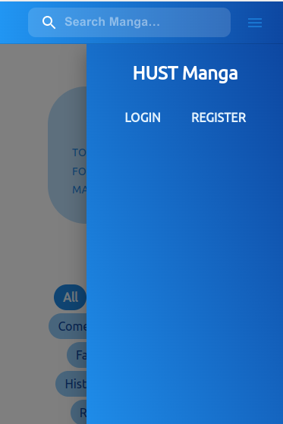
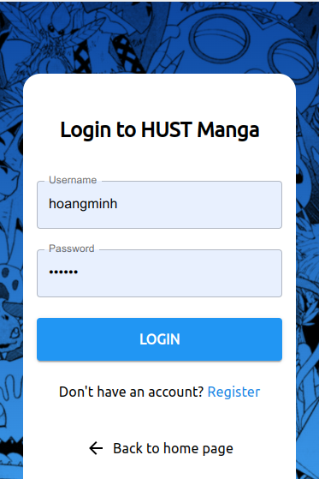
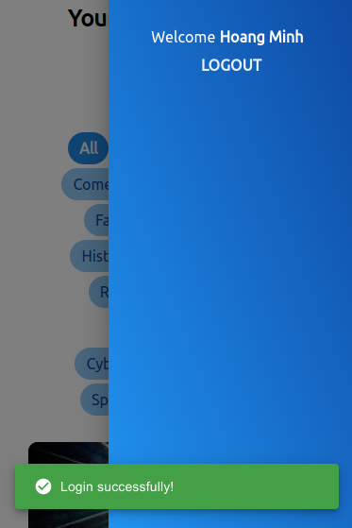
Login
Click LOGIN
Submit Login information
Welcome!

Slide 18
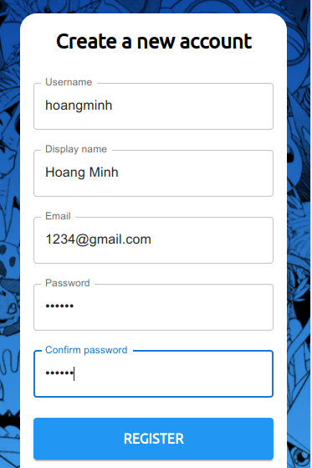
Register
Click REGISTER
Submit Login information

Slide 19


Add manga to favorite (Require login)
Click “Heart” symbol to add
a manga to favorite
The manga is added to the favorite list

Slide 20
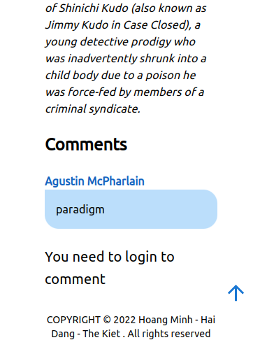
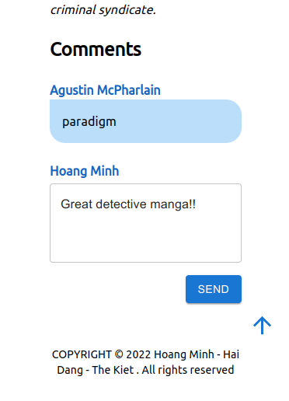
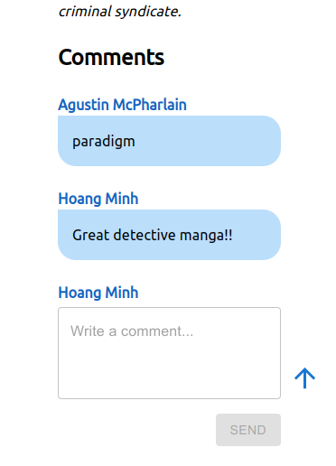
Comment on a manga (Require Login)

Slide 21
4. Contributions of Members

Slide 22
Contribution of members:
Nguyễn Lưu Hoàng Minh:
Coding Front-end, connecting Back-end with database, deploying web application, server and database, making slides
Trần Hải Đăng:
Coding Back-end, designing and writing APIs.
Đinh Thế Kiệt:
Designing and managing database, writing APIs, collecting data.

Slide 23
5. Demo

Slide 24
THANKS FOR WATCHING!

